Slide 1



Restful services
Session
11
Chaim Turkel
Ido Barash

Slide 2


Last session - Web services
Web-services introduction
JAX-B
SOAP web-services
JAX-WS

Slide 3
Restful services
SOAP problems
HTTP
REST
JAX-RS

Slide 4

SOAP problems
SOAP-based web services are good, but the technology has some problems.
The main problem with SOAP messages: there are just too many standards (WS*: WS-Security, WS-Policy, WS-discovery, etc…)
Due to complexity, Clients uses code generators to consume WS data. This looks nice until fine-tuning is needed.
SOAP forces us to strictly stick with a schema (It can be considered as a disadvantage and an advantage),.

Slide 5
SOAP problems
Actually, There is already a ‘way’ which is quite interoperable and exists for years.
All browsers and clients are familiar with this ‘way’ with no any extra languages and implementations.
HTTP

Slide 6
HTTP
HTTP – well known protocol with built in CRUD (Create, Read, Update and Delete) operations as HTTP methods.

Slide 7
HTTP
HTTP – well known protocol with built in CRUD (Create, Read, Update and Delete) operations as HTTP methods.
GET:
POST:
PUT:
DELETE:

Slide 8
HTTP
HTTP – well known protocol with built in CRUD (Create, Read, Update and Delete) operations as HTTP methods.
GET: Read
POST:
PUT:
DELETE:

Slide 9
HTTP
HTTP – well known protocol with built in CRUD (Create, Read, Update and Delete) operations as HTTP methods.
GET: Read
POST: Create
PUT:
DELETE:

Slide 10
HTTP
HTTP – well known protocol with built in CRUD (Create, Read, Update and Delete) operations as HTTP methods.
GET: Read
POST: Create
PUT: Update
DELETE:

Slide 11
HTTP
HTTP – well known protocol with built in CRUD (Create, Read, Update and Delete) operations as HTTP methods.
GET: Read
POST: Create
PUT: Update
DELETE: Delete

Slide 12
REST
REST: REpresentational State Transfer
REST is an architecture style. It is an abstract idea and not a technology or protocol (SOAP is a protocol).
REST is not a standard.
REST states a set of rules defining how we should design a web app to achieve more scalable, more simple and interoperable app.

Slide 13
REST
The application is abstracted to resources.
A resources is basically every noun that is a part of the interface between the server and the client.
Each resource has a unique Uniform Resource Identifier (URI).
Resources has an “interface” with well-defined operations to change their state. (HTTP methods for example)
The protocol should be simple, client-server and cacheable (usually HTTP).

Slide 14
REST
The resources move between server and clients with a representation state.
This representation is based on a normal MIME-type such as:
Text
Xml
JSON

Slide 15
REST: WADL
WADL: Web Application Description Language.
SOAP web services has WSDL file describing the service interface in XML.
RESTful services has WADL file, which describes all the available resources , and their parameters.

Slide 16
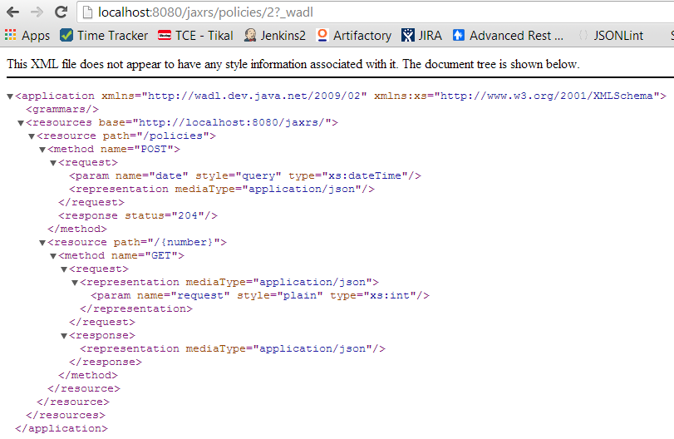
REST: WADL

Slide 17
JAX-RS
JAX RS: Java API for XML REstful Services
A JEE specification defining how to expose REstful services.
Using annotations, the JAX-RS provider will take an interface and will generate servlets, serializers and objects that are needed for the REST service.
JAX-RS is considered as one of the best specifications ever because of it’s simplicity.

Slide 18
JAX-RS
In SOAP, an interface and the implementing class represents a single service.
In REST, each resource symbols a service, therefore an interface and the implementing class represents several services.

Slide 19
JAX-RS: path
Since URL is the service identifier, the basic annotation for JAX-RS is @Path, which can be set on both types and methods.
@Path("/policies/")
public interface PolicyServices {
@Path("/getPolicy")
public Policy getPolicy(Integer number);
}

Slide 20
JAX-RS: path
Since URL is the service identifier, the basic annotation for JAX-RS is @Path, which can be set on both types and methods.
@Path("/policies/")
public interface PolicyServices {
@Path("/getPolicy")
public Policy getPolicy(Integer number);
}
The @Path on the type defines URL prefix for all method of the interface.
The @Path on the method defines URL postfix for the specific method

Slide 21
JAX-RS: path
Since URL is the service identifier, the basic annotation for JAX-RS is @Path, which can be set on both types and methods.
@Path("/policies/")
public interface PolicyServices {
@Path("/getPolicy")
public Policy getPolicy(Integer number);
}
The @Path on the type defines URL prefix for all method of the interface.
The @Path on the method defines URL postfix for the specific method
The get policy service URL: /policies/getPolicy

Slide 22
JAX-RS: parameters
A path represents a resource.
But a resource might not be unique:
There can be more than one policy (for example)
In order to distinctly recognize resources we use path parameters:
@Path("/policies/")
public interface PolicyServices {
@Path("/{number}")
public Policy getPolicy(@PathParam("number") Integer policyNumber);
}

Slide 23
JAX-RS: parameters
A path represents a resource.
But a resource might not be unique:
There can be more than one policy (for example)
In order to distinctly recognize resources we use path parameters:
@Path("/policies/")
public interface PolicyServices {
@Path("/{number}")
public Policy getPolicy(@PathParam("number") Integer policyNumber);
}
/policies/15 resource1 → policy 15
/policies/200 resource2 → policy 200

Slide 24
JAX-RS: parameters
Parameters which has nothing to do with the resources definition declared by:

Slide 25
JAX-RS: parameters
Parameters which has nothing to do with the resources definition declared by:
Query parameters
Matrix parameters
Form parameters
Cookie parameters
Header parameters
Entity parameter

Slide 26
JAX-RS: parameters
Query parameters: after the URL for example: /policies/15?date=15/02/2015

Slide 27
JAX-RS: parameters
Query parameters: after the URL for example: /policies/15?date=15/02/2015
@Path("/{number}")
public Policy getPolicy(@PathParam("number") Integer policyNumber,
@QueryParam("date") Date date);

Slide 28
JAX-RS: parameters
Matrix parameters:
@Path("{number}")
public Policy getPolicy(@PathParam("number") Integer policyNumber,
@MatrixParam("agent") Integer agentId,
@MatrixParam("customer") Integer coustomerId);
Usage: /policies/15;agent=1;customer=6
/policies/200; → both matrix parameters = null
/policies/250;customer=6 → agentId = null

Slide 29
JAX-RS: parameters
Matrix parameters: So, what's the difference between query and matrix parameters?

Slide 30
JAX-RS: parameters
Matrix parameters: So, what's the difference between query and matrix parameters? matrix parameters are part of the URL and are not part of the request. Request parameters can be sent too: /policies/15;agent=1;customer=6?parameter=aa

Slide 31
JAX-RS: parameters
Matrix parameters: So, what's the difference between query and matrix parameters? matrix parameters are part of the URL and are not part of the request. Request parameters can be sent too: /policies/15;agent=1;customer=6?parameter=aa
Also:
No encoding of “?” and “&” needed
Query parameters sometimes not cached – matrix parameters does.
Matrix parameters has good supports for list: agentid=1,3,4;

Slide 32
JAX-RS: parameters
Form parameters: part of HTML form
@Path("{number}")
public Policy getPolicy(@PathParam("number") Integer policyNumber,
@FormParam("agent") Integer agentId);

Slide 33
JAX-RS: parameters
Form parameters: part of HTML form
@Path("{number}")
public Policy getPolicy(@PathParam("number") Integer policyNumber,
@FormParam("agent") Integer agentId);
Usage: /policies/15
But the service is activated by a HTML form: <form action="http://appServer:8080/appName/policies/15" method="GET">
<label>agent Id:</label>
<input type="text" name="agent" />
</form>

Slide 34
JAX-RS: parameters
Cookie parameters: parameter that is stored in a cookie
@Path("{number}")
public Policy getPolicy(@PathParam("number") Integer policyNumber,
@CookieParam("agent") Integer agentId);

Slide 35
JAX-RS: parameters
Cookie parameters: parameter that is stored in a cookie
@Path("{number}")
public Policy getPolicy(@PathParam("number") Integer policyNumber,
@CookieParam("agent") Integer agentId);
This is a bad practice !!!
we prefer not to be dependent on the client browsing abilities.

Slide 36
JAX-RS: parameters
Header parameters: Part of the HTML header
@Path("{number}")
public Policy getPolicy(@PathParam("number") Integer policyNumber,
@HeaderParam(“db-id") Integer dbId);

Slide 37
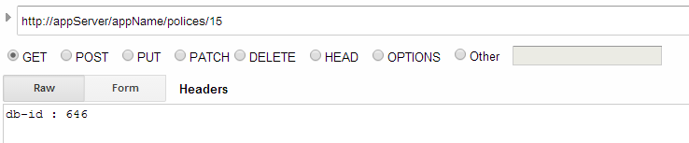
JAX-RS: parameters
Header parameters: Part of the HTML header
@Path("{number}")
public Policy getPolicy(@PathParam("number") Integer policyNumber,
@HeaderParam(“db-id") Integer dbId);
Usage:

Slide 38
JAX-RS: parameters
Entity parameter: Part of the HTML body
@Path(“/")
public void savePolicy(Policy policy);

Slide 39
JAX-RS: parameters
Entity parameter: Part of the HTML body
@Path(“/")
public void savePolicy(Policy policy);
This parameter sent to us a JSON, XML or text.
We use it only in POST and PUT methods.
Each resource can have only one entity parameter!

Slide 40
JAX-RS: HTTP methods
JAX-RS provide us simple HTTP methods annotations to declare resource state manipulation:
@GET
@Path("/{number}")
public Policy getPolicy(Integer number);
@POST
public void createPolicy(Policy policy);
@DELETE
public void deletePolicy(Policy policy);
@PUT
public void updatePolicy(Policy policy);
@PUT
@Path("/{number}")
public void policyAgentSwitch(@PathParam("number") Integer policyId, Agent agent);

Slide 41
JAX-RS: Request/Response
JAX-RS can consume and produce request and response data as JSON, text or XML messages.
In order to decide which type will be used: @Consumes and @Produces annotations.
@Path("/policies/")
@Consumes(MediaType.APPLICATION_JSON)
@Produces(MediaType.APPLICATION_XML)
public interface PolicyServices {
@POST
@Consumes(MediaType.TEXT_PLAIN)
public void createPolicy(Policy policy);
}

Slide 42
JAX-RS: Service Implementation
The implementing class can not have any annotations regarding the Restful service.
@PUT
@Override
@Path("/{number}")
public void policyAgentChangeSwitch(@PathParam("number") Integer policyId, Agent agent) {

Slide 43
JAX-RS: Service Implementation
The implementing class can not have any annotations regarding the Restful service.
@PUT
@Override
@Path("/{number}")
public void policyAgentChangeSwitch(@PathParam("number") Integer policyId, Agent agent) {
This will cause weird behavior in some JAX-RS implementations.

Slide 44
JAX-RS: Service Implementation
The implementing class can not have any annotations regarding the Restful service.
@PUT
@Override
@Path("/{number}")
public void policyAgentChangeSwitch(@PathParam("number") Integer policyId, Agent agent) {
This will cause weird behavior in some JAX-RS implementations. The correct way to implement:
@Override
public void policyAgentChangeSwitch(Integer policyId, Agent agent) {

Slide 45
JAX-RS
JAX-RS is just a specification. It only defines annotations we can use to create RESTful services easily.
If we use a full JEE app server, we will get the JAX-RS implementation from the app server itself.
Without an app server, we have to provide an implementation JAR on our own and configure it. This can be tricky – since each implementation requires different configuration.
Common implementations: CXF, RestEasy, Jersey, etc..

Slide 46
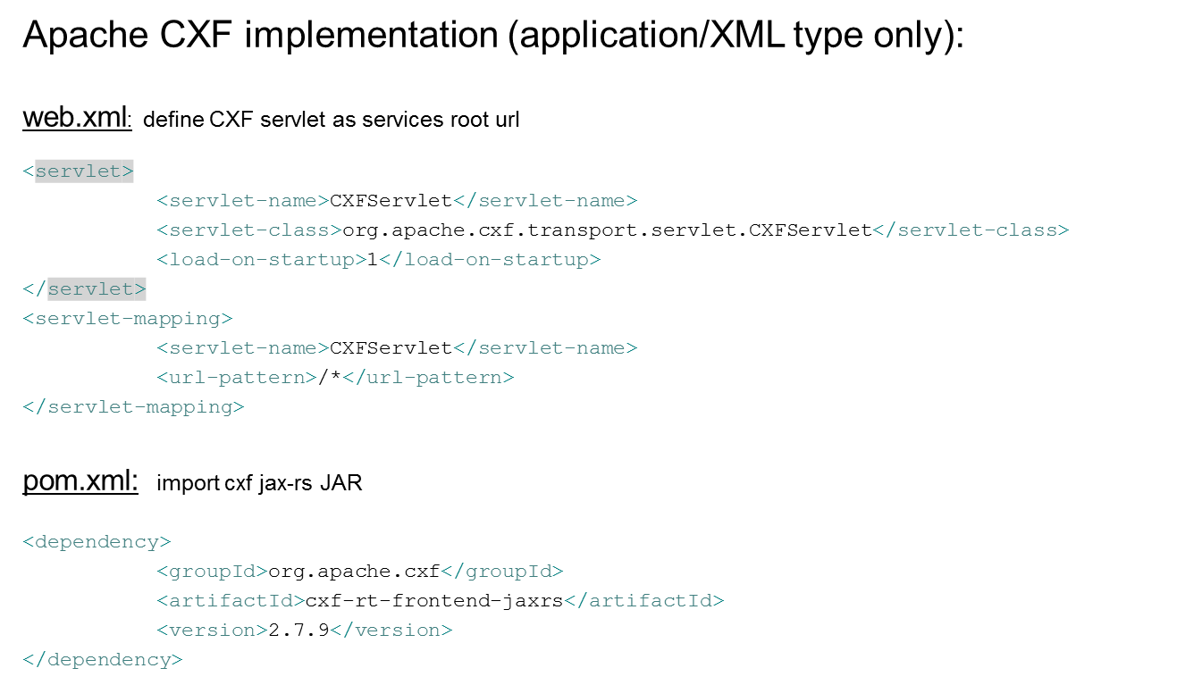
JAX-RS: Configuration

Slide 47
JAX-RS: Configuration
Apache CXF implementation (application/XML type only):
Pom.xml: import jackson JSON serializer - for JSON request and response
<dependency>
<groupId>org.codehaus.jackson</groupId>
<artifactId>jackson-xc</artifactId>
<version>1.9.13</version>
</dependency>
<dependency>
<groupId>org.codehaus.jackson</groupId>
<artifactId>jackson-core-asl</artifactId>
<version>1.9.13</version> </dependency> <dependency>
<groupId>org.apache.cxf</groupId>
<artifactId>cxf-rt-frontend-jaxrs</artifactId>
<version>2.7.9</version>
</dependency>
<dependency>
<groupId>org.codehaus.jackson</groupId>
<artifactId>jackson-jaxrs</artifactId>
<version>1.9.13</version>
</dependency>

Slide 48
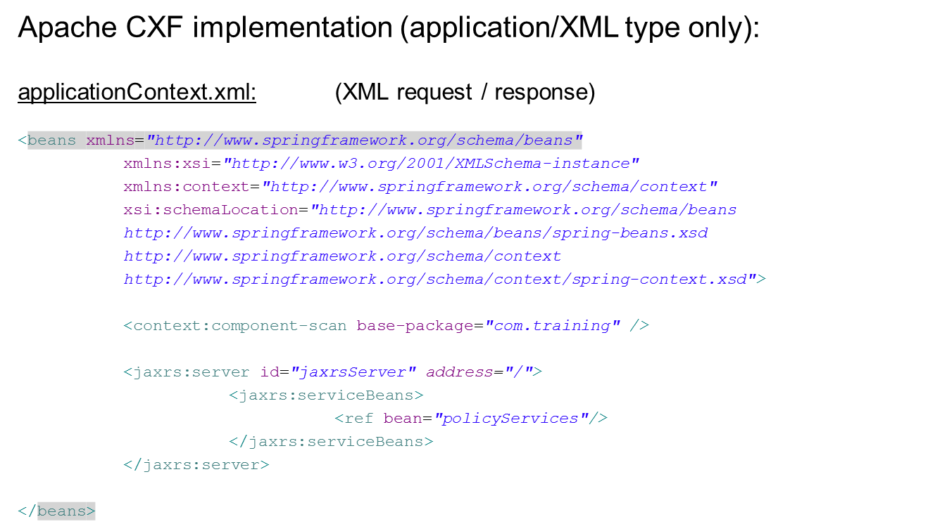
JAX-RS: Configuration

Slide 49
JAX-RS: Configuration
Every REST service must be listed under “service-beans”

Slide 50
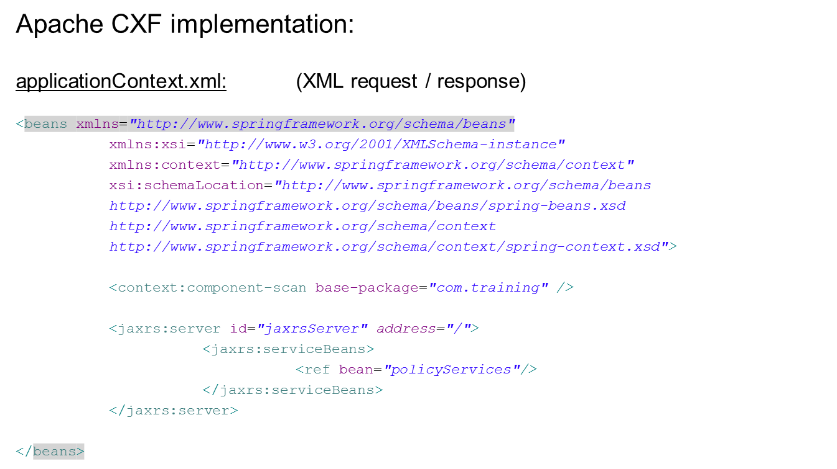
JAX-RS: Configuration

Slide 51
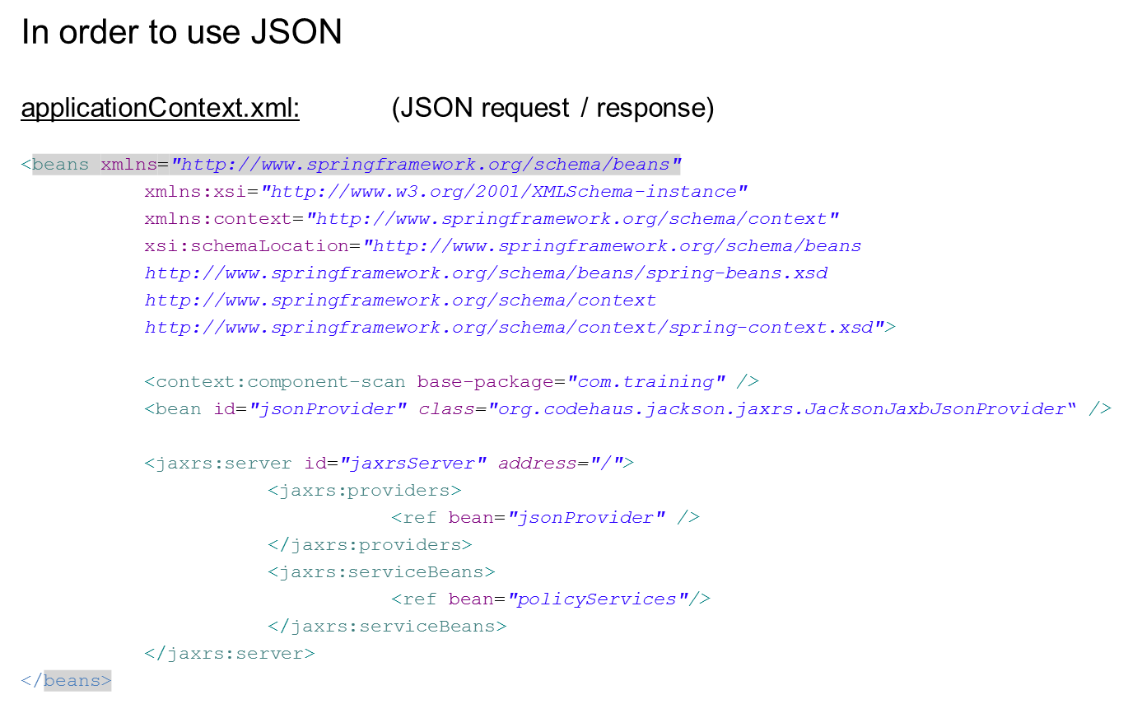
JAX-RS: Configuration

Slide 52
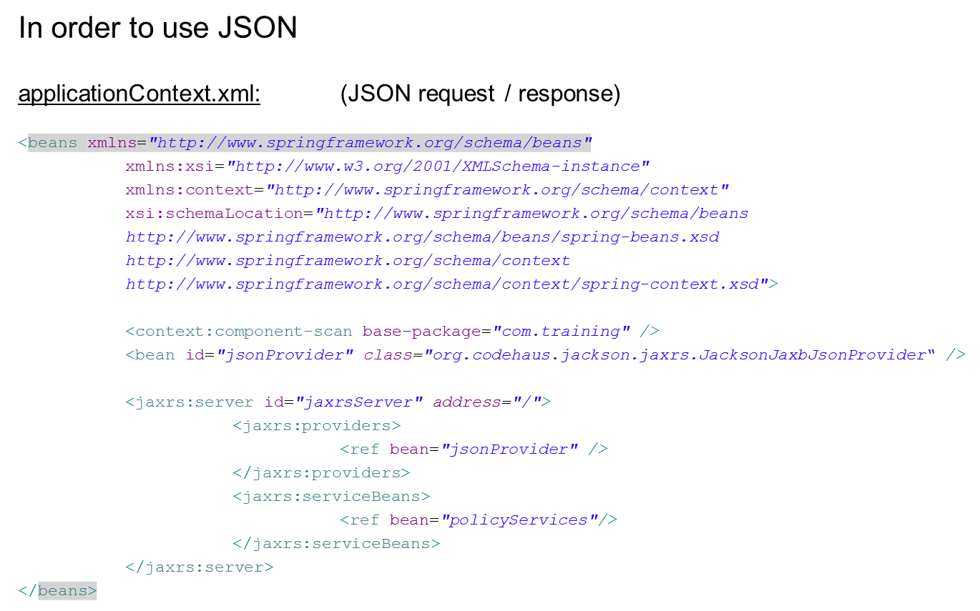
JAX-RS: Configuration

Slide 53
JAX-RS: Exercise
Exercise: Library
A library has books (Integer id, String name)
Provide RESTful service with the following resources:
Add new book
Get all books.
Get a single book by id
Move book to shelf (assume that shelves has distinctive integer id)
Delete a book by it’s id.
You were provided with a template project containing an interface called “BooksServices” and it’s implementation “BookServicesRestImpl”. Your task is to make the service RESTful using JAX-RS.

Slide 54
JAX-RS: Exercise - Solution
@Path("/books")
@Produces(MediaType.APPLICATION_JSON)
@Consumes(MediaType.APPLICATION_JSON)
public interface BooksServices {
@GET
@Path("/{id}")
public Response getBook(@PathParam("id") Integer bookId);
@GET
@Path("/")
public Response getAll();
@PUT
@Path("/")
public Response addBook(Book book);
@POST
@Path("/{id}/move")
public Response moveToShelf(@PathParam("id") Integer bookId,
@QueryParam("from") Integer fromShelf,
@QueryParam("to") Integer toShelf);
@DELETE
@Path("/{id}")
public Response deleteBook(@PathParam("id") Integer book);
{

Slide 55
JAX-RS: Exercise - Solution
@Service("booksServices")
public class BookServicesRestImpl implements BooksServices {
<?xml version="1.0" encoding="UTF-8"?>
<beans xmlns="http://www.springframework.org/schema/beans"
xmlns:xsi="http://www.w3.org/2001/XMLSchema-instance" xmlns:jaxrs="http://cxf.apache.org/jaxrs"
xmlns:context="http://www.springframework.org/schema/context"
xsi:schemaLocation="http://www.springframework.org/schema/beans
http://www.springframework.org/schema/beans/spring-beans.xsd
http://cxf.apache.org/jaxrs http://cxf.apache.org/schemas/jaxrs.xsd
http://www.springframework.org/schema/context
http://www.springframework.org/schema/context/spring-context.xsd">
<context:component-scan base-package="com.training" />
<bean id="jsonProvider" class="org.codehaus.jackson.jaxrs.JacksonJaxbJsonProvider" />
<jaxrs:server id="jaxrsServer" address="/">
<jaxrs:providers>
<ref bean="jsonProvider" />
</jaxrs:providers>
<jaxrs:serviceBeans>
<ref bean="booksServices" />
</jaxrs:serviceBeans>
</jaxrs:server>
</beans>

Slide 56
Overview - Restful services
SOAP problems
HTTP
REST
JAX-RS

Slide 57
Next session – Unit tests
Unit tests
JUnit
Mockito
TDD

Slide 58


THANK YOU
Ido Barash
Email: ido.barash@tikalk.com

